Slide 1
Dimensionality Reduction
Principal Component Analysis

Slide 2
What is PCA
summarization of data with many (p) variables by a smaller set of (k) derived (synthetic, composite) variables
p
k
A
X
n
n

Slide 3
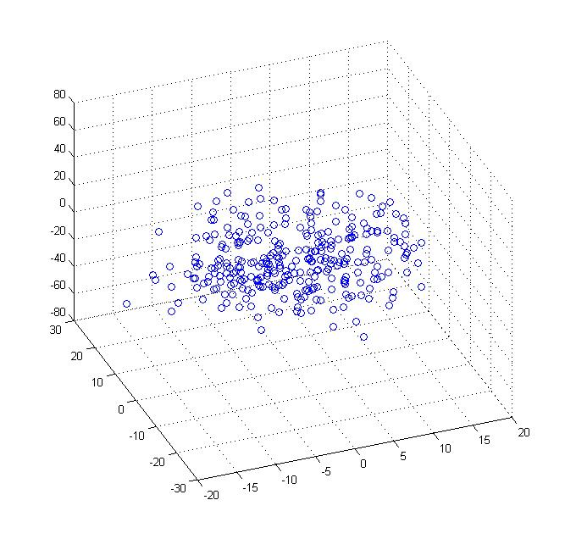
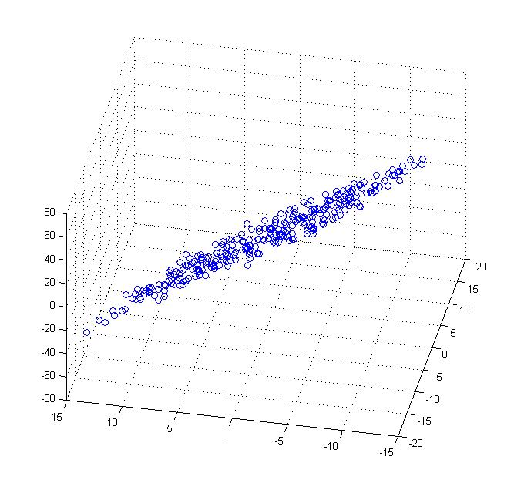
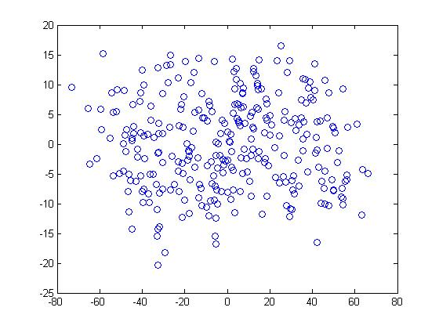

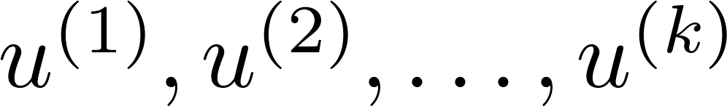
Principal Components- Form
Reduce from 2-dimension to 1-dimension: Find a direction (a vector )onto which to project the data so as to minimize the projection error.
Reduce from n-dimension to k-dimension: Find vectors
onto which to project the data, so as to minimize the projection error.

Slide 4
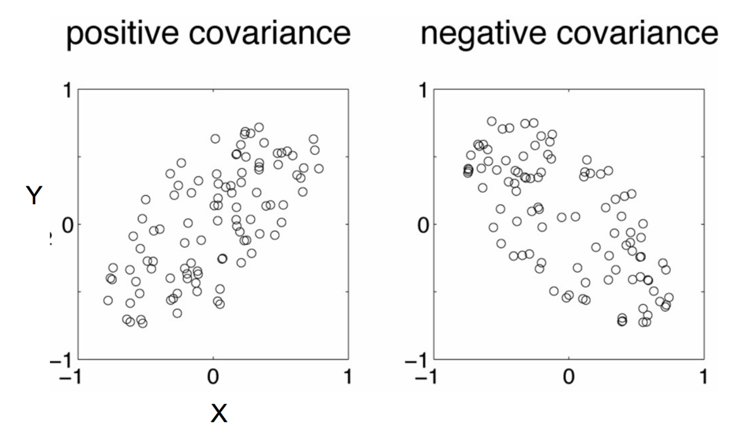
Covariance
Variance and Covariance:
Measure of the “spread” of a set of points around their center of mass(mean)
Variance:
Measure of the deviation from the mean for points in one dimension
Covariance:
Measure of how much each of the dimensions vary from the mean with respect to each other
Positive: Both dimensions increase or decrease together
Negative: While one increases the other decrease

Slide 5

Eigenvector and Eigenvalue
Ax - λx = 0
(A – λI)x = 0
Ax = λx
B = A – λI
Bx = 0
If we define a new matrix B:
x = B⁻¹0 = 0
BUT! an eigenvector cannot be zero!!
If B has an inverse:
x will be an eigenvector of A if and only if B does not have an inverse, or equivalently det(B)=0 :
det(A – λI) = 0

Slide 6
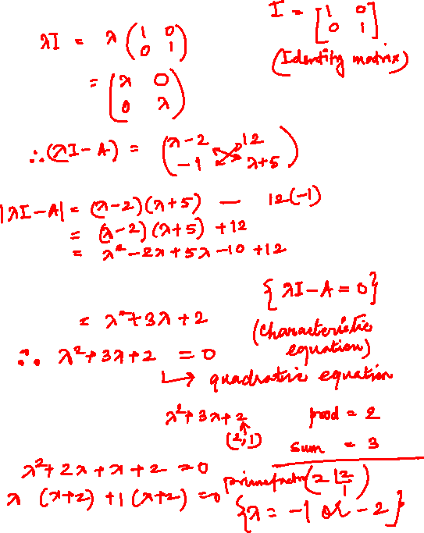




Eigenvector and Eigenvalue
$$A=\left[\begin{matrix}2 & −12 \\ 1 & −5\end{matrix}\right]$$
Example 1: Find the eigenvalues of
two eigenvalues: −1, − 2
Note: The roots of the characteristic equation can be repeated. That is, λ₁ = λ₂ =…= λ_{k}. If that happens, the eigenvalue is said to be of multiplicity k.
Example 2: Find the eigenvalues of
λ = 2 is an eigenvector of multiplicity 3.
$$\left|λI−A\right|=\left|\begin{matrix}λ−2 & 12 \\ −1 & λ+5\end{matrix}\right|=(λ−2)(λ+5)+12 \\ =λ^{2}+3λ+2=(λ+1)(λ+2)$$
$$A=\left[\begin{matrix}2 & 1 & 0 \\ 0 & 2 & 0 \\ 0 & 0 & 2\end{matrix}\right]$$
$$\left|λI−A\right|=\left|\begin{matrix}λ−2 & −1 & 0 \\ 0 & λ−2 & 0 \\ 0 & 0 & λ−2\end{matrix}\right|=(λ−2)^{3}=0$$

Slide 7
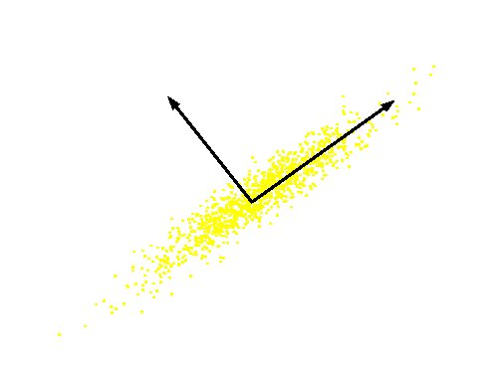

Computing the components
The new Axes or components are eigenvectors of the matrix of correlations of the original variables
Transfer a set of correlated variables into a new set of uncorrelated variables
PCj = ai1Y1 + ai2Y2 + … ainYn
aij’s are the coefficients for factor i, multiplied by the measured value for variable j New axes are orthogonal and represent the directions with maximum variability
PC 2
PC 1
Original Variable B
Original Variable A

Slide 8
Expected Output
The first PC retains the greatest amount of variation in the sample
The k^{th} PC retains the k^{th} greatest fraction of the variation in the sample
The k^{th} largest eigenvalue of the correlation matrix C is the variance in the sample along the k^{th} PC

Slide 9
Dimensionality Reduction
For n original dimensions, we get a nxn correlation matrix, which leads to eigenvectors.
We reduce dimension by focusing on the important components
N dimensions in original data
Calculate n eigenvectors and eigenvalues
Choose only the first p eigenvectors based on their eigenvalues
Data reduces to p dimensions p<n

